Slide 1
APACHE SPARK
Lightning-Fast Big Data Analysis

Slide 2

What is Spark?
“Fast and General Purpose Cluster Computing Platform”
Apache Spark is a powerful open source processing engine built around speed, ease of use, and sophisticated analytics.
-Databricks, Inc.
Spark comes packed with:
Support for ETL (Extract, Transform, Load).
Interactive Queries (SQL).
Advanced Analytics (Machine Learning).
Streaming on large datasets.

Slide 3



Not so long ago!
Started in 2009 as a research project in the UC Berkeley RAD Lab.
Open sourced in 2010.
Quickly became the largest open source community in Big Data, with over 500 contributors and 200+ organizations.

Slide 4
I’ve already made a lot of Friends
 | June 2013 | June 2014
Total Contributors | 68 | 255
Companies contributing | 17 | 50
Total lines of code | 63,000 | 175,000

Slide 5
And there’s a lot of activity going on

Slide 6


On the ‘Speed’ side
Interactive Queries
Stream Processing
Interactive Data Exploration
Minutes or Hours?
The ability to run computations in memory.

Slide 7
On the ‘Generality’ side
BlinkDB
Approximate SQL
Spark
SQL
Spark Streaming
Streaming
MLlib
Machine Learning
GraphX
Graph Computation
Spark R
R on Spark
Spark Core Engine
Unified Platform for Big Data Apps

Slide 8
The ‘Elephant’ vs. The ‘Eel’
Hadoop | Spark
Hive | Spark SQL
Apache Mahout | MLlib
Impala | Spark SQL
Apache Giraph | GraphX
Apache Storm | Spark Streaming
* Spark offers simple APIs in Python, Java, Scala, and SQL, and rich built-in libraries.

Slide 9
Unification brings one Abstraction
Resilient Distributed Datasets:
All different processing systems in Spark share the same abstraction called RDD.
An RDD in Spark is simply an immutable distributed collection of objects.
RDDs are lazily evaluated, type inferred, and can be cached in memory.
RDDs are logically divided where each division is called a ‘Partition’.

Slide 10
Creating RDDs
RDDs can be created in two ways:
By loading an external dataset or
By distributing a collection of objects
Spark can create these distributed datasets from any file stored on HDFS or other storage systems supported by Hadoop APIs (including Cassandra, Amazon S3, Hbase, or local file system.

Slide 11
Creating RDDs
Creating an RDD with textFile() in Python:
>>> lines = sc.textFile(“README.md”)
Creating an RDD with textFile() in Scala:
scala> val lines = sc.textFile(“README.md”)
Creating an RDD with textFile() in Java:
JavaRDD<String> lines = sc.textFile(“README.md”)

Slide 12
RDD Operations
RDDs offer two types of operations:
Transformations.
Actions.
‘Transformations’ construct a new RDD from a previous one.
‘Actions’ compute a result based on an RDD, and either return it to the driver program or save it to an external storage system (ex. HDFS).

Slide 13
Transformations
“Transformations are operations on RDD that return a new RDD.”
Some Transformations:
map(func) – return a new distributed dataset formed by passing each element of the source through a function ‘func’.
filter(func) – return a new dataset formed by selecting those elements of the source on which ‘func’ returns true.
union(otherDataset) – return a new dataset that contains the union of elements in the source dataset and the argument.

Slide 14
Transformations
filter() transformation in Python:
>>> lines = sc.textFile(“README.md”)
errorsRDD = lines.filter(lambda x: “errors” in x)
filter() transformation in Scala:
scala> val lines = sc.textFile(“README.md”)
scala> val errorsRDD = lines.filter(line => line.contains(“error”))
filter() transformation in Java:
JavaRDD<String> lines = sc.textFile(“README.md”);
JavaRDD<String> error = lines.filter(new Function<String, Boolean>() {
public Boolean call(String x) {return x.contains(“error”);
}}
});

Slide 15



Transformations
filter() for “errors”
inputRDD
filter() for “warnings”
errorsRDD
warningsRDD
union()
badLinesRDD

Slide 16
Actions
“Actions are operations on RDD that return a final value to the Driver program or write data to an external storage system.”
Some Actions:
collect() – return all the elements of the dataset as an array at the Driver program.
count() – return the number of elements in the dataset.
first() – return the first element of the dataset.
reduce(func) – Aggregate the elements of the dataset using a function ‘func’ . The function should be commutative and associative so that it can be computed correctly in parallel.

Slide 17
Actions
count() Action in Python:
>>> print “input file had” + badLinesRDD.count() + “concerning lines”
print “Here are 10 examples:”
for line in badLinesRDD.take(10):
print line
count() Action in Scala:
println(“Input had” + badLinesRDD.count() + “concerning lines”)
println(“Here are 10 examples:”)
badLines.take(10).foreach(println)

Slide 18
Actions
count() Action in Java:
System.out.println(“Input had” + badLinesRDD.count() + “concerning lines”);
System.out.println(“Here are 10 examples:”);
for(String line: badLinesRDD.take(10)){
System.out.println(line);
}

Slide 19
Persistence (Caching)
“To avoid computing an RDD multiple times, we can ask Spark to ‘persist’ the data.”
Job 1
RDD3
a1
Output Data
t3
Input Data
t1
RDD1
t2
RDD2
t4
RDD4
a2
Output Data
Job 2

Slide 20
Persistence Levels
Level | Space Used | CPU Time | In Memory | On Disk | Comments
MEMORY_ONLY | High | Low | Yes | No
MEMORY_ONLY_SER | Low | High | Yes | No
MEMORY_AND_DISK | High | Medium | Some | Some | Spills to the disk if there is too much data to fit in memory.
MEMORY_AND_DISK_SER | Low | High | Some | Some | Spills to the disk if there is too much data to fit in memory.
DISK_ONLY | Low | High | N | Y

Slide 21
Persistence (Caching)
persist() method to persist RDDs in Scala:
val result = input.map(x => x * x)
result.persist(StorageLevel.DISK_ONLY)
println(result.count())
println(result.collect().mkString(“,”))
“RDDs come with a method called ‘unpersist()’ that lets us manually remove them from the cache.”

Slide 22
Running a Spark Job

Slide 23


Running a Spark Job
Steal the moon
Master (Daemon)
Workers
(Executors)

Slide 24
Running a Spark Job
Spark Driver
(Driver Program)
Cluster Master (YARN, Mesos, or Standalone)
Cluster Worker
(Executor)
Cluster Worker (Executor)
Cluster Worker
(Executor)

Slide 25
Running a Spark Job
Application
Job
Job
Executor
Executor
Executor
Task
Task
Task
Task
Task
Task

Slide 26
Spark Driver
Manages job flow and scheduling.
Typically, same as the client process to initiate the job.
Responsible for performing ‘transformations’ and ‘actions’ on RDDs and submit requests to the Master.
In practical terms:
Driver is a program that creates the SparkContext, connecting to a given Spark Master.

Slide 27
Spark Executor
A single JVM instance on a node that serves a single Spark Application.
Each application gets its own executor processes, which stay up for the duration of the whole application and runs tasks in multiple threads.
One Executor can run multiple tasks over its lifetime.
A node may have several Executors.

Slide 28
Pluggable Resource Manager
“Spark supports pluggable Cluster Manager, which is responsible for starting executor processes”
Spark supports three Cluster Managers:
YARN
Mesos
Spark’s own ‘Standalone’ Cluster Manager.
All three of these frameworks have two components:
A central ‘Master’ service.
A ‘Slave’ service running on each node.

Slide 29
Pluggable Resource Manager
The Central Master Service:
YARN ResourceManager
Mesos Master
Spark Standalone Master
The Slave Service:
YARN NodeManager
Mesos Slave
Spark Standalone Slave

Slide 30
A Spark Job
Standalone Mode

Slide 31



Spark Job - Standalone Mode
Driver Program

Slide 32
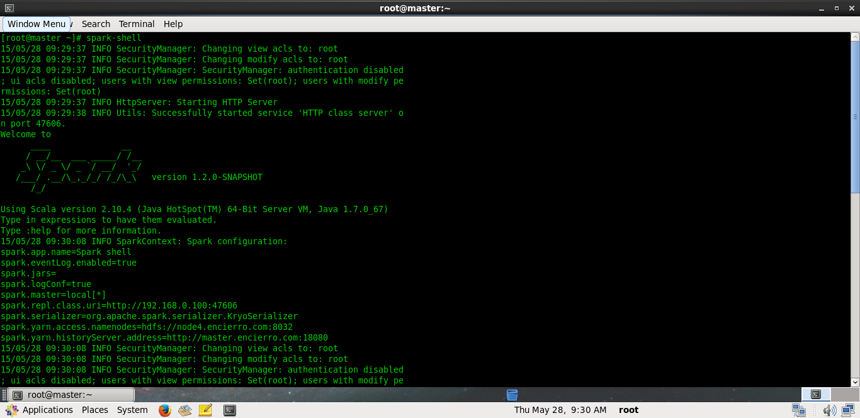
Standalone Spark Shell – Scala (spark-shell)

Slide 33
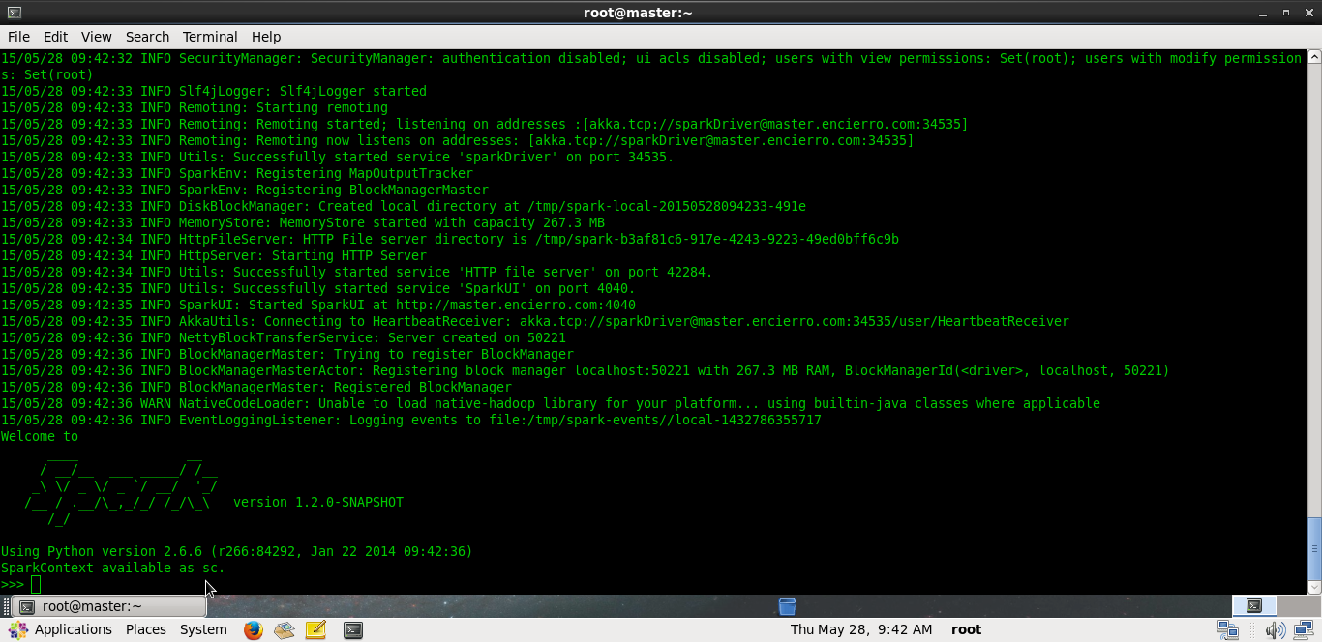
Standalone Spark Shell – Python (pyspark)

Slide 34
A Spark Job
YARN Mode

Slide 35
Spark Job - YARN Mode
Spark Application Master:
Responsible for negotiating resource requests made by the driver with YARN.
Finds suitable set of hosts/containers in which to run the Spark applications.

Slide 36
Spark Job - YARN Mode
NodeManager
Client
Job
NodeManager
Resource Manager
Spark Application Master
NodeManager
Job
NodeManager

Slide 37
Spark Job - YARN Mode
Spark runs on YARN in two modes:
YARN ‘Cluster’ Mode.
YARN ‘Client’ Mode.
“YARN Cluster mode makes sense for production jobs.”
“YARN Client mode makes sense for interactive and debugging issues.”

Slide 38
Spark Job - YARN Mode (Cluster)
Cluster Mode:
Driver runs in the Application Master
The client that starts the application doesn’t need to stick around for its entire lifetime.

Slide 39
Spark Job - YARN Mode (Cluster)
YARN Container
YARN Resource Manager
Spark Application Master
2
Client
1
Spark Driver
Launch Application
Request resource/reply
Launch Spark Executor
Issue Application commands
4
3
YARN Node Manager
YARN Container
YARN Container
Spark Executor
Spark Executor
Spark Task
YARN Cluster Mode

Slide 40
Spark Job - YARN Mode (Client)
Client Mode:
Driver program runs in the YARN Client.
The Application Master is merely present to request executor containers from YARN.
The client communicates with these containers to schedule work after they start.

Slide 41
Spark Job - YARN Mode (Client)
YARN Container
YARN Resource Manager
Spark Application Master
2
Client
1
Spark Driver
Launch Application
Request resource/reply
Launch Spark Executor
Issue Application commands
4
3
YARN Node Manager
YARN Container
YARN Container
Spark Executor
Spark Executor
Spark Task
YARN Client Mode

Slide 42
Running a Spark Job
 | YARN Cluster | YARN Client | Spark Standalone
Driver runs in: | Application Master | Client | Client
Who requests resources? | Application Master | Application Master | Client
Who starts executor processes? | YARN NodeManager | YARN NodeManager | Spark Slave
Persistent Services | YARN ResourceManager & NodeManagers | YARN ResourceManager & NodeManagers | Spark Master & Workers
Supports Spark Shell | No | Yes | Yes

Slide 43
Tuning Spark

Slide 44
Configuring with SparkConf
“Changing Spark runtime configurations.”
Using SparkConf in Python:
conf = new SparkConf()
conf.set(“spark.app.name”, “My App”)
conf.set(“spark.master”, “yarn”)
conf.set(“spark.ui.port”, “36000”)
sc = new SparkContext(conf)
Construct a conf.
Create a SparkContext with this configuration

Slide 45
Configuring with SparkConf
Using SparkConf in Scala:
val conf = new SparkConf()
conf.set(“spark.app.name”, “My App”)
conf.set(“spark.master”, “yarn”)
conf.set(“spark.ui.port”, “36000”)
val sc = new SparkContext(conf)
Construct a conf.
Create a SparkContext with this configuration
Using SparkConf in Java:
SparkConf conf = new SparkConf();
conf.set(“spark.app.name”, “My App”);
conf.set(“spark.master”, “yarn”);
conf.set(“spark.ui.port”, “36000”);
JavaSparkContext sc = new JavaSparkContext(conf);

Slide 46
Configuring with spark-submit
Setting configuration values at runtime using flags:
$ bin/spark-submit \
--class com.example.MyApp \
--master yarn \
--name “My Spark App” \
--conf spark.ui.port=36000 \
myApp.jar
Setting configuration values at runtime using a defaults file:
$ bin/spark-submit \
--class com.example.MyApp \
--properties-file my-config.conf \
myApp.jar

Slide 47
Some Common Spark Configurations
Option | Default | Explanation
spark.executor.memory (--executor-memory) | 512M | Amount of memory to user per executor process.
spark.executor.cores (--executor-cores) | 1 | Bounds the number of cores used by the application.
spark.cores.max (--total-executor-cores) | (none) | Total number of cores across all the executors.
spark.speculation | False | Setting to True will enable speculative execution of tasks.
spark.eventLog.enabled | False | Set True to enable event logging, which allows completed tasks to be viewed using a history server.
spark.eventLog.dir | File:///tmp/spark-events | The storage location used for event logging, if enabled.

